Slide 1
Seventh-day Adventist Church – North England Conference
Rebuilding the Walls:
Rebuilding People;
Restoring Relationships;
Inspiring Excellence.
(Ephesians 4:1-13)

Slide 2

Dynamic Sermon Design and Delivery
Adapted with permission from the IICM Course, LCL 106, planned and compiled by Gebre Worancha, DPTh.

Slide 3
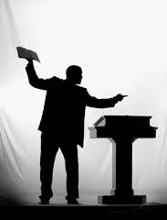
Resources
Stickland, Mike J. Heralds of God’s Word, GC Ministerial Assn, 1998
Sunukjian, Donald R, Invitation to Biblical Preaching: Proclaiming Truth with Clarity and Relevance, Kregel Publications, PO Box 2607 Grand Rapids MI 49501
Larson, Craig & Robinson, Haddon (General Editors) Art & Craft of Biblical Preaching, Christianity Today International, 2005

Slide 4
Introduction
Schedule
  Dates
  Time
  Venue
Objectives – p.5
Course Material
  Course Notes
  Resource
Requirements
Grades

Slide 5
Pre-eminent
Role of the ‘Laity’
“Without Lay Leaders our church would come to a halt.” M J Stickland
  Priesthood of all believers.
  Adventist modus operandi.
  More churches than salaried pastors.
  Ministry of the Word.
  Evangelism & Church planting.
  Lay Preachers Licence.

Slide 6

Lay Preaching…
…Is not about:
  Achieving public affirmation and recognition
  Filling vacant slots in the preaching schedule
  An opportunity to ride hobby horse
  An opportunity to “put a few things straight”
…Is about:
  Meeting the needs of your congregation
  Revealing the majestic grace of God; the beauty of Jesus; the power of the Holy Spirit.

Slide 7
Lay Preacher Challenges
Personal
  Domestic & Employment demands…
  Limited Resources
  Time & Space
Pastoral Factors
  Part of a Team
General
  Low regard for preaching
  Worship Facilities

Slide 8
Sun 17 Nov 2013
Introduction
Lecture 1: The Voice...
Lecture 2: How to Prepare a Sermon

Slide 9

Definitions…
Homiletics:
  The art of preaching or writing sermons
Sermon… (Preparation)
  (Notes: p. 15)
Preaching… (Delivery)

Slide 10
Personal Preparation
(Stickland,15-20)
Time (Manage your time)
  Upon the right improvement of our time depends our success in acquiring knowledge and mental culture. EGW, COL, p. 343
  A resolute purpose, persistent industry and careful economy of time, will enable men to acquire knowledge and mental discipline which will qualify them for almost any position of influence and usefulness. EGW, COL, 344

Slide 11
Personal Preparation
(Stickland,15-20)
Study of God’s Word
  Those who stand before the people as teachers of truth are to grapple with great themes. They are not to occupy precious time in talking on trivial subjects. Let them study the Word, and preach the Word. Ev 151
  It is a sin for those who accept to teach the Word to others to be themselves neglectful of its study. GW 249

Slide 12
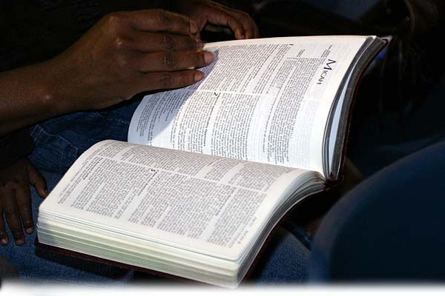
Personal Preparation
(Stickland,15-20)
Methods of Bible Study
  Topical
  Book , chapter, section
  Whole story, incident
  Biographical
  Devotional

Slide 13
Personal Preparation
(Stickland,15-20)
Writings of Ellen White
  Encounter Reading Guides
  Original works
  Compilations
  Manuscripts
  Cautions

Slide 14

Personal Preparation
(Stickland,15-20)
Wide General Reading
  Theological
  Devotional
  Biographical
  General knowledge
  Journals -
  Newspapers
  Denominational literature

Slide 15
Personal Preparation
(Stickland,15-20)
Develop a Filing System
  Filing cabinet
  Concertina folder
  Used envelopes
  Computer
  Folders and pockets
  Etc…

Slide 16

Personal Preparation
(Stickland,15-20)
Cultivate the habit of Making Notes
  Of: Thoughts, ideas, suggestions, observations, stories, etc
  From: Reading, working, conversations, Listening to others preaching, nature, sports, etc…

Slide 17
Personal Preparation
Voice Culture
“In reading the Bible, in engaging in prayer, in bearing testimony in meeting, how necessary is clear, distinct utterance! And how much is lost in family worship when the one offering prayer bows the face down and speaks in a low, feeble voice! But as soon as family worship is over, those who could not speak loud enough to be heard in prayer, can usually speak in clear, distinct tones, and there is no difficulty in hearing what they say.” {EGW, CT 241.1}

Slide 18
Deciding What to Preach
Stickland, p. 32 - 38
The Congregation – make up of…
The Occasion / Event – Church calendar
Seasonal activities
Your Competence – ability / limitations
Your Purpose – 2 Tim 3:16 – 4:2
Your Brief – instruction received
Other…

Slide 19
Deciding What to Preach
Stickland, p. 32 - 38
Cautions on choice of Topic / Text
  Avoid obscure texts
  Avoid peculiar interpretations/explanations of Scripture
  Avoid hobby horses
  Avoid taking a text out of context
  Avoid preaching personal opinions
  Be a preacher, not a lecturer
  Make it palatable and digestible

Slide 20
Finding Information:
Tools of the Preacher’s Trade
The Bible –
  Version/translation
  Reference
  Study
  Etc…
Bible Concordance
  Analytical (Young’s)
  Exhaustive (Strong’s)
  Topical (Cruden’s)
  Etc…

Slide 21
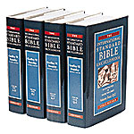
Finding Information:
Tools of the Preacher’s Trade
Dictionaries
  Theological
  English
  Specialised, technical
Encyclopaedias
  Bible
  General

Slide 22
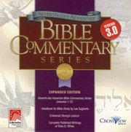
Finding Information:
Tools of the Preacher’s Trade
Commentaries
Theological books
Periodicals
Journals
Magazines

Slide 23
Finding Information:
Tools of the Preacher’s Trade
The Internet
  www.adventist.org
    Fundamental beliefs
    The Church Manual
    Official statements
    Documents
  www.adventistbiblicalresearch.org

Slide 24
Preparing a
Sermon Outline
A Sermon Outline…
  is a way of organising a sermon in an orderly and progressive manner.
  Guides the thoughts of the preacher
  Keeps the preacher on track
  Aids the hearer’s understanding
  Aids the hearer’s memory

Slide 25
The 3 parts of a Sermon Outline
The Introduction (Notes, p. 16,17)
The Main Body (Notes, p. 17)
The Conclusion (Notes, p. 17)

Slide 26
Break (15 minutes)

Slide 27
Sun 17 Nov 2013
Introduction
Lecture 1: The Voice...
Lecture 2: How to Prepare a Sermon

Slide 28
Importance of
Public Speaking
Gospel commission (Matt. 28:19-20)
Nature of preaching:
  kerusso – “to announce, summon, declare” Mt. 4:12-17
  didasko – “to teach” Mt. 4:23; 22:16; Acts 5:18-21
  Cf: 1 Tim. 4:13-15; 1 Cor. 9:16; Rom. 10:15; 2Cor. 2:17;
  1 Cor. 14:18

Slide 29
Importance of
Public Speaking
1. Jesus and public speaking (John 7:46)
2. Church Leaders and public speaking
  E G White and voice culture:
  “In all our ministerial work, more attention should be given to the culture of the voice. We may have knowledge, but unless we know how to use the voice correctly, our work will be a failure.” Gospel Workers, p. 86

Slide 30
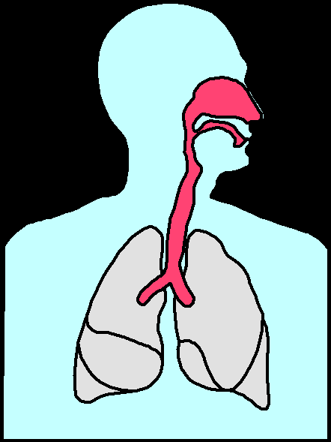
Developing your
Speaking Voice
MECHANISM OF SOUND AND SPEECH
Nasal Cavity
Nostril
Vocal Chords
Tongue
Mouth
Lungs

Slide 31
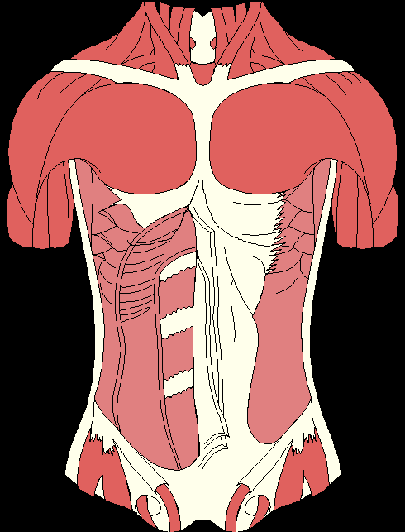
Developing your
Speaking Voice
MECHANISM OF SOUND AND SPEECH
Chest Muscles
Diaphragm
Abdominal Muscles

Slide 32
Developing your
Speaking Voice
CORRECT BREATHING
Exercise

Slide 33
Developing your
Speaking Voice
Speaking Clearly
  Tongue Twister Exercises
Use of Good Language
  Avoid Slangs
  Avoid Euphemisms

Slide 34
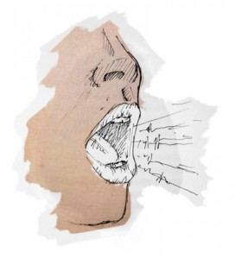

Now time to do some exercises!

Slide 35
The Ministry of the Word #1
The Early Church (Read Acts 6:1-7)
Four Steps:
  They established the principle (6:2)
  They made a proposal (6:3, 4)
  They established a priority (6:4)
  They enjoyed the result (6:7)
  Bob Gordon, Personally Speaking, p38-45

Slide 36
Ministry of the Word…
When we speak of the ministry of the Word we are recognising that we mean something spiritual and not just physical.
The ministry of the Word has one chief aim in view. (Col. 3:16; 2 Cor. 4:5)
The ministry of the Word is nothing short of the presentation of the revelation of God himself.
Bob Gordon, Personally Speaking, p46-50

Slide 37
7 Convictions of Biblical Preaching
The Bible is the Word of God.
The entire Bible is the Word of God
The Bible is self-authenticating
This leads to a ‘Thus saith the Lord’
Try to get at the intent of the Biblical writer
The Bible is a Book about God
We don’t make the Bible relevant; we show it’s relevance.
    Haddon Robinson, Art & Craft of Biblical Preaching, p:23ff

Slide 38
Keep in Mind
3 Great Axioms
Don’t ever dare to stand in front of a group of people with a Bible in your hand and not expect change.
Remember that the goal of all preaching is transformation.
At the end of the day, the effectiveness of our preaching will burst forth from the holiness of our personal lives.
Crawford Loritts, Art & Craft of Biblical Preaching, p36

Slide 39
Life Changing
Preaching is…
Bible Based
  God’s standard – God Himself
  God’s provision – The Holy Spirit who…
    Created us after God’s image (Genesis. 1:27)
    Convicts us of our hopelessness / helplessness (John 16:8)
    Breathes new life into us (John 3:6)
    Creates us anew with vastly new potential (2 Cor. 5:17)
    Takes up residence within us (John 14:17)
    Gave us the Scriptures (2 Tim. 3:16,17)
    Transforms us from glory to glory (2 Cor. 3:18)
  Our responsibility – (Heb. 12:1,2; Acts 20:31)

Slide 40
Life Changing
Preaching is…
Spirit-energised
  Indications of a Spirit-filled life.
    Feeling (Luke 10:21)
    Relationship (Eph. 4:29-32; 5:15-18)
    Fruitage (Galatians 5:22-23)
    Gifts (1 Cor. 12)

Slide 41
Life Changing
Preaching is…
Verdict-Demanding
  “Change comes by Spirit power when choices are made, so preaching must be demanding if Spiritual formation and transformation is to occur”
Audience-connected
  Translates message into contemporary language and thought forms.
  Exegete your audience.

Slide 42
Assignment
Review…
  Today’s presentation
Read
  Course notes
  Sunukjian ch.1 & 2 and appendix A.
Write
  A simple sermon outline
Do
  Breathing exercises
  Speech exercises

Slide 43
And Finally…
NEXT TIME…
Lecture 3: How to Select a Theme
Lecture 4: How to Choose & Interpret a text

